Slide 1
General examination in pediatrics

Slide 2
Differences in Pediatric Physical Examination Compared to Adults
•Gather as much data as possible by observation first
•Position of child: parent’s lap vs exam table
•Stay at the child’s level as much as possible.
•Order of exam: least distressing to most distressing.
•Distraction is a valuable tool
    •Examine painful area last

Slide 3
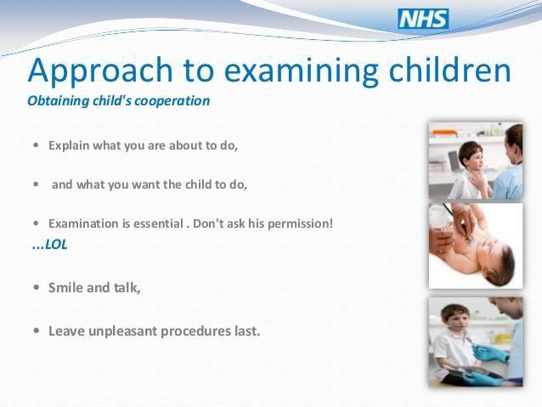

Slide 4
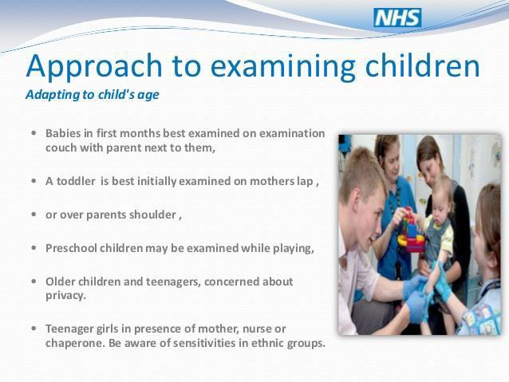

Slide 5
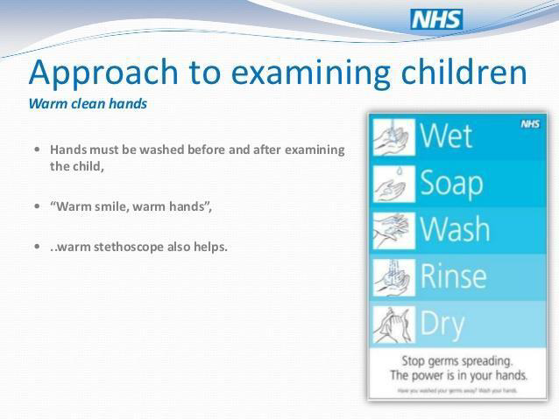

Slide 6
Pediatric age groups:
0 day – 28 day Neonate:
1year-29 day Infant:
1-3 years Toddler:
Children: 3– 12years
Adolescent: 12 yr-18yr

Slide 7
General examination:
General look: (well, ill, toxic)
•position in bed : comfortable or not
•conscious level
•Cardinal signs : for pallor/jaundice/ cyanosis
•Hydration status : well hydrated , dehydrated : sunken eye , sunken fontanel, dry tongue , no tears. over hydrated :puffy eyelids
•body built: average, under or over built,
•Vital signs: pulse, temperature, respiratory rate, blood pressure
•anthropometric measurements :
weight ,length\height, head circumference.
Put them on growth charts according to age.
•gait / abnormal facial features / apparent congenital malformation/ cubitus.

Slide 8
Vital signs
•temperature
•heart rate
•respiratory rate
•blood pressure

Slide 9
Normally child differ than adults, and vary according to age
Temperature:
•Grade:
✓ average normal 37 ˚C (98.6 ˚F)
✓ Infant & children ˃ 1 years old :
normal value 36.6(97.9 ˚F) -37.2 ˚C(99 ˚F)
✓ up to 37.7 ˚C for <1 years old
•Route: oral( same reading) vs. Axillary (+0.5˚C) vs. rectal (-0.5˚C)
•Fever˃ 37.7˚C
➢Low grade < 38.5 ˚C
➢High grade ( 38.5 –41 ˚C )
➢Hyperpyrexia ˃ 41 ˚C

Slide 10
Heart rate:
•Comment on rate, rhythm ,volume , special character.
•Rate ( newborn 140 – infant 120 – preschool 100 –school children 90 ) ±20 beat / min.
•Beat / minute according to age.
•Auscultate or palpate apical pulse or palpate femoral pulse in infant.
Palpate ant. cubital or radial pulse in older child.

Slide 11
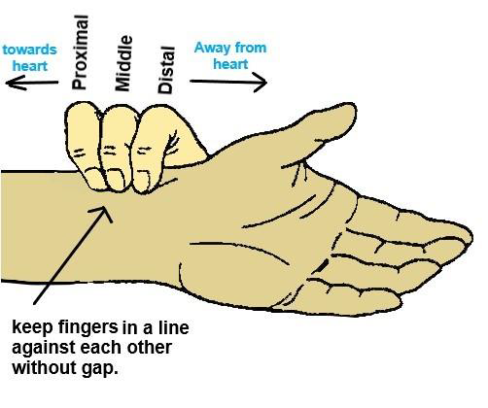

Slide 12
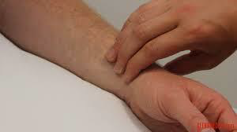
Palpation of radial artery:

Slide 13
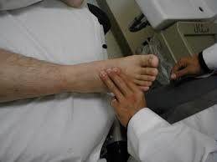
Palpation of dorsalis pedis artery:

Slide 14
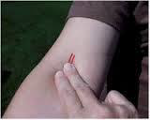
Palpation of brachial artery:

Slide 15
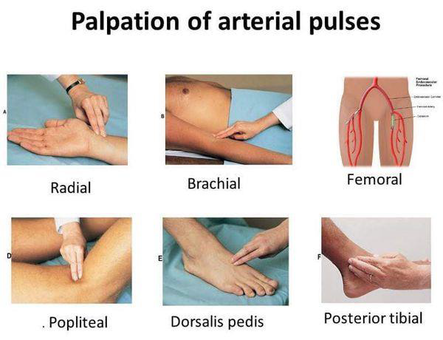

Slide 16
:respiratory rate
Observe for a minute. Infants normally have periodic breathing so that observing for only 15 seconds will result in a skewed number.
•Blood pressure :
Appropriate size cuff 2/3width of upper arm.

Slide 17
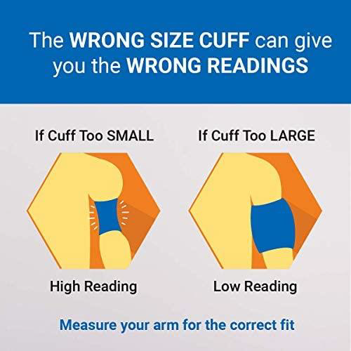

Slide 18
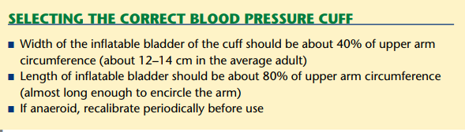

Slide 19
Measurements (Plot On Growth Chart)
Weight
Length or Height
Head Circumference
Chest cirumferance

Slide 20
weight
Age | Average weight, kg
At birth | 3.25
3-12 months | Age (months) + 9 2
1- 6 years | Age (year) x 2+8
7-12 years | (Age (year) x 7)-5 2

Slide 21
Height/ length
Age | Average, cm
At birth | 50
At 1 year | 75
At 2 year | 87.5
3-12 years | (Age (year) x 6) +77 or (Age (year) x 5) + 80

Slide 22
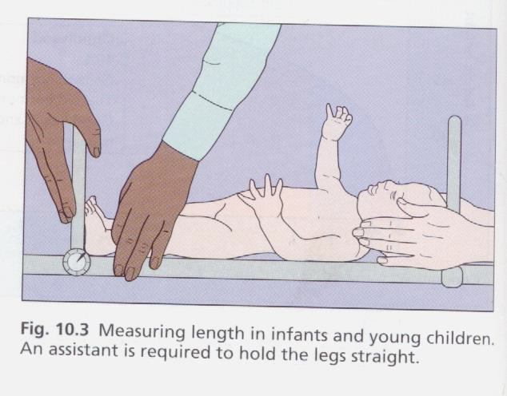
Measuring the lenghth:

Slide 23
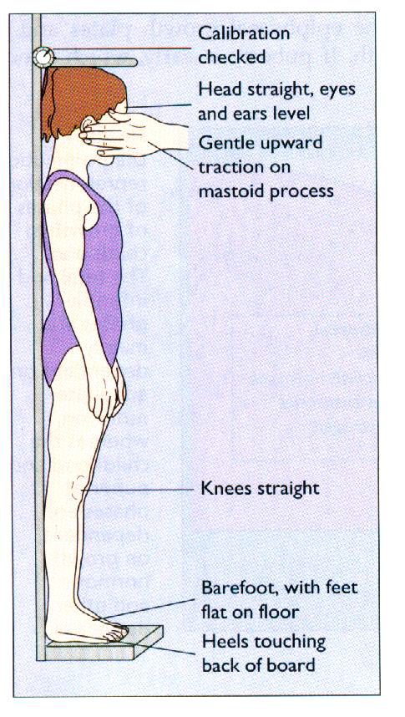
Measuring the height:

Slide 24
Head circumference (HC)
Age | Average HC, cm
At birth | 35
At 6 months | 44
At 1 year | 47
At 2 year | 49
2 - 7 year: increases by ½ cm / year.
8 - 12 year: increases by ⅓ cm / year.

Slide 25
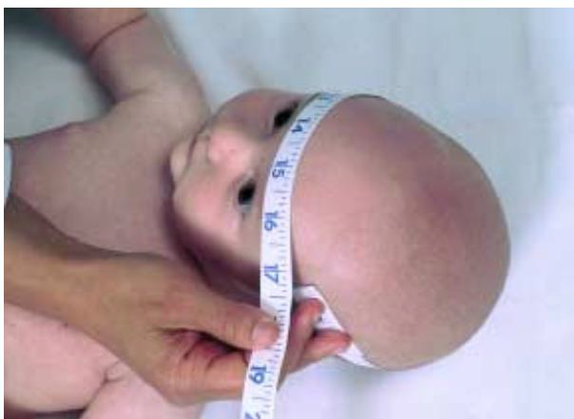
Measuring head circumferance by measuring the greatest circumferance bet. Occipital and frontal prominance.

Slide 26
Chest circumference
Age | Average, cm
At birth | 33
1 year | 47
1-10 years: yearly gain 1.5 cm
11-15 years: yearly gain 3 cm
At birth HC > CC
9-12 months HC = CC
After 1 year CC > HC

Slide 27
III -TEETHING
(A)Deciduous (Milk) Teeth :
❖ They are 20 in number (10 in each Jaw)
❖ They appear in the following order :
-Central incisors 6 -8 mon
-Lateral incisors 10 –12 mon
-First molar 12 –14 –mon
-Canines 16 –18 mon
-Second molars 20-22 mon

Slide 28
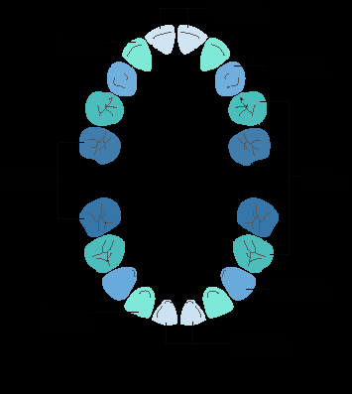

Slide 29
(B) Permanent teeth :
They are 32 in number (16 in each Jaw)
They appear in the following order:
-First molar 6 years
-Central incisor 7 years
-Lateral incisors 8 years
-First premolar 10 years
-Canine 11 years
-Second molar 12 years
18-25 years -Wisdom teeth

Slide 30
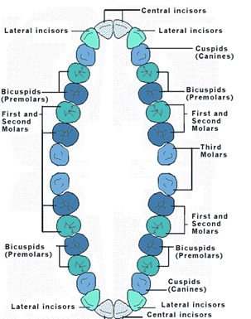

Slide 31
CHILDREN NEED EVALUATION
Those with 2 S.D less than or above 95th % or less than 5th %
Those with disproportionate growth chart
Those with abnormal growth pattern.

Slide 32


Slide 33
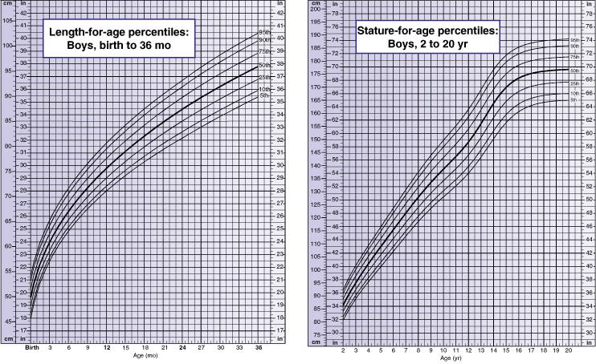

Slide 34
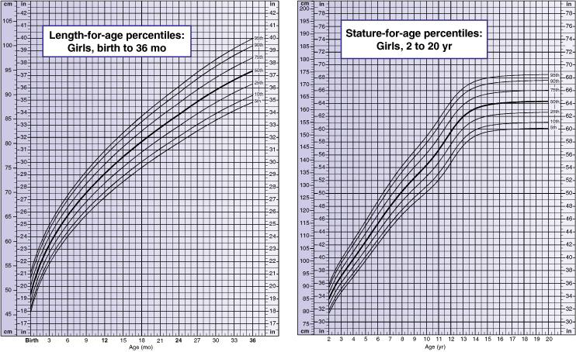

Slide 35
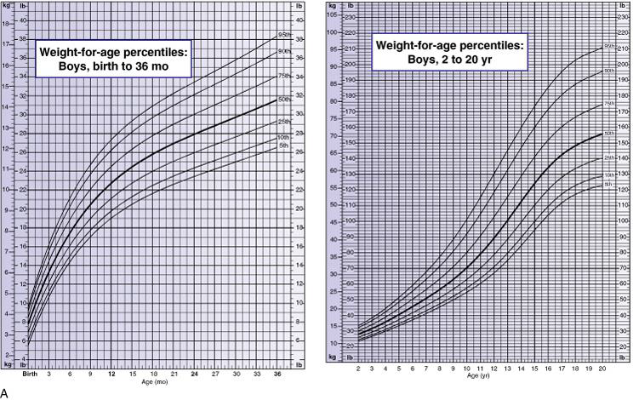

Slide 36
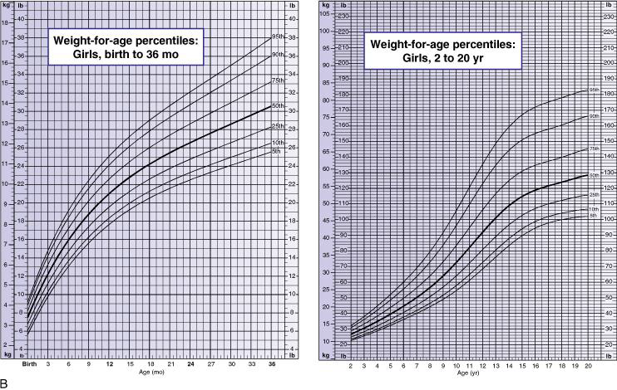

Slide 37
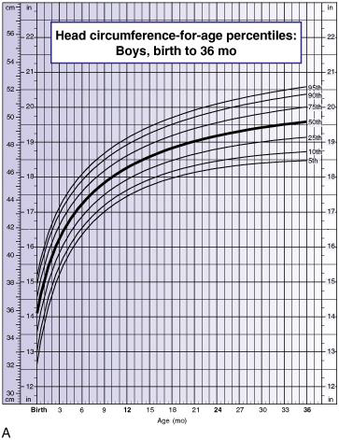

Slide 38
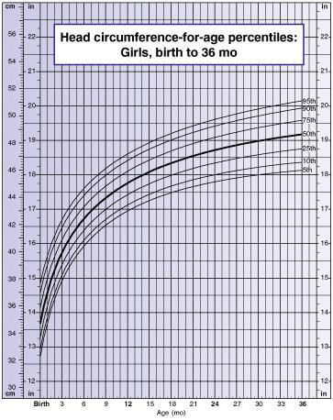

Slide 39
Head examination:
*pallor, jaundice, cyanosis
*normal or abnormal shape :box shape in rickets
*Fontanel size if open : wide in rickets
*hair: silky..., coarse brittle...., easily detachable, flag sign....
* Normal or abnormal facies.
Mongolian facies…down syndrome
thalassemic facies ... Thalassemia
*Eye, nose, ear ex: puffy or sunken eyes and if there is any abnormality like proptosis, depressed nasal bridge, low set ears
*skin & Mucous membranes :
-pallor: anemia
-cyanosis: respiratory failure, cyanotic heart dis
- rash

Slide 40
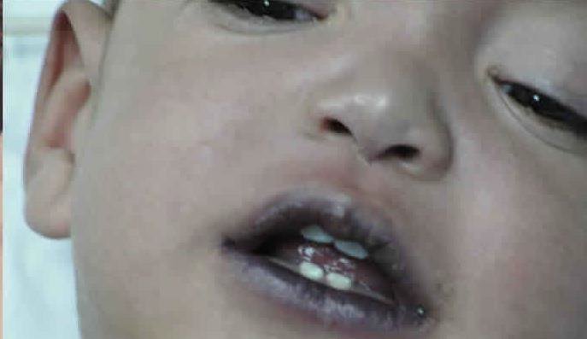
Central cyanosis:

Slide 41
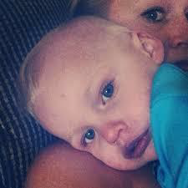
Central cyanosis:

Slide 42
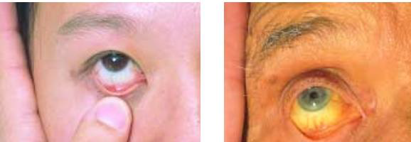
jaundice
Normal vs jaundice

Slide 43
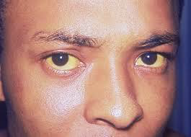
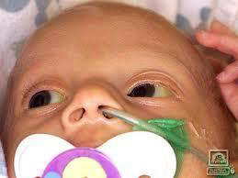
jaundice

Slide 44
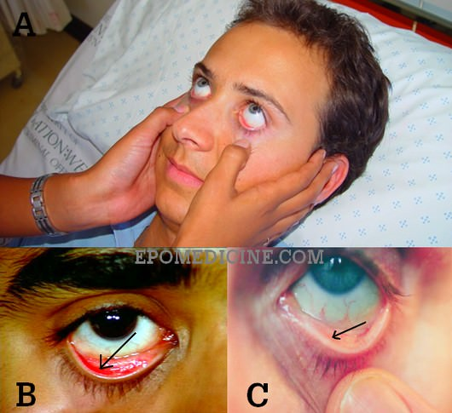
pallor

Slide 45
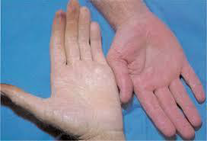
pallor

Slide 46
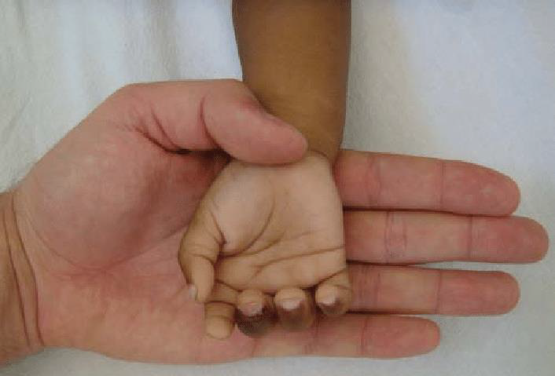
pallor

Slide 47
FONTANELLES :
❖ There are 6 fontanelles : (1. Anterior & 1. Posterior 2. Sphenoid and 2 mastoid)
❖ The anterior & Posterior ones are clinically important.
*The post. Fontanelle : closes at full term or 1-2 mon later
*The Ant. Fontenelle : is 3 fingers at birth (average 4-5cm)
*2 fingers at 6 month
*1 finger at 1 year. closed at 1.5yr

Slide 48
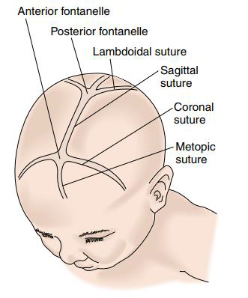

Slide 49
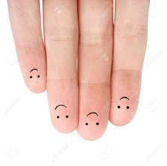
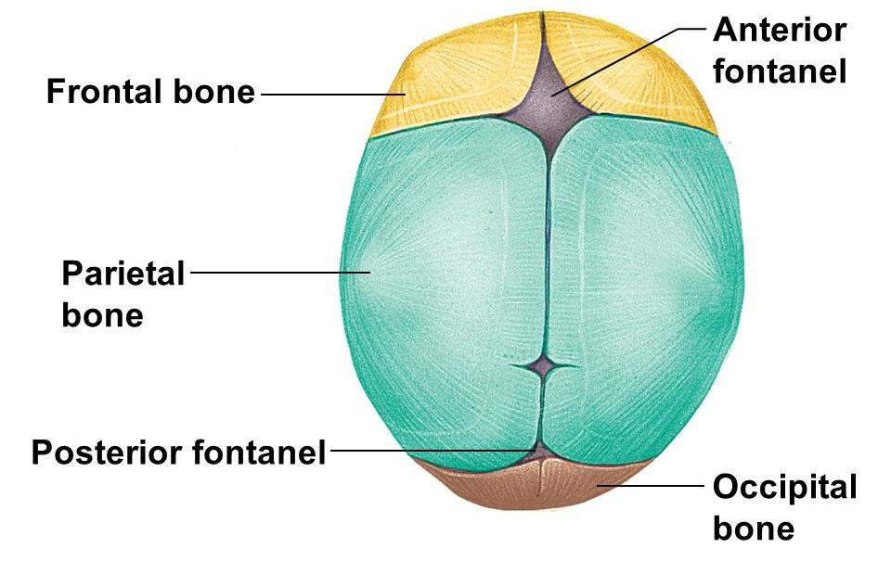

Slide 50
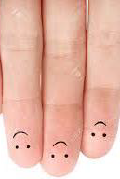

Slide 51
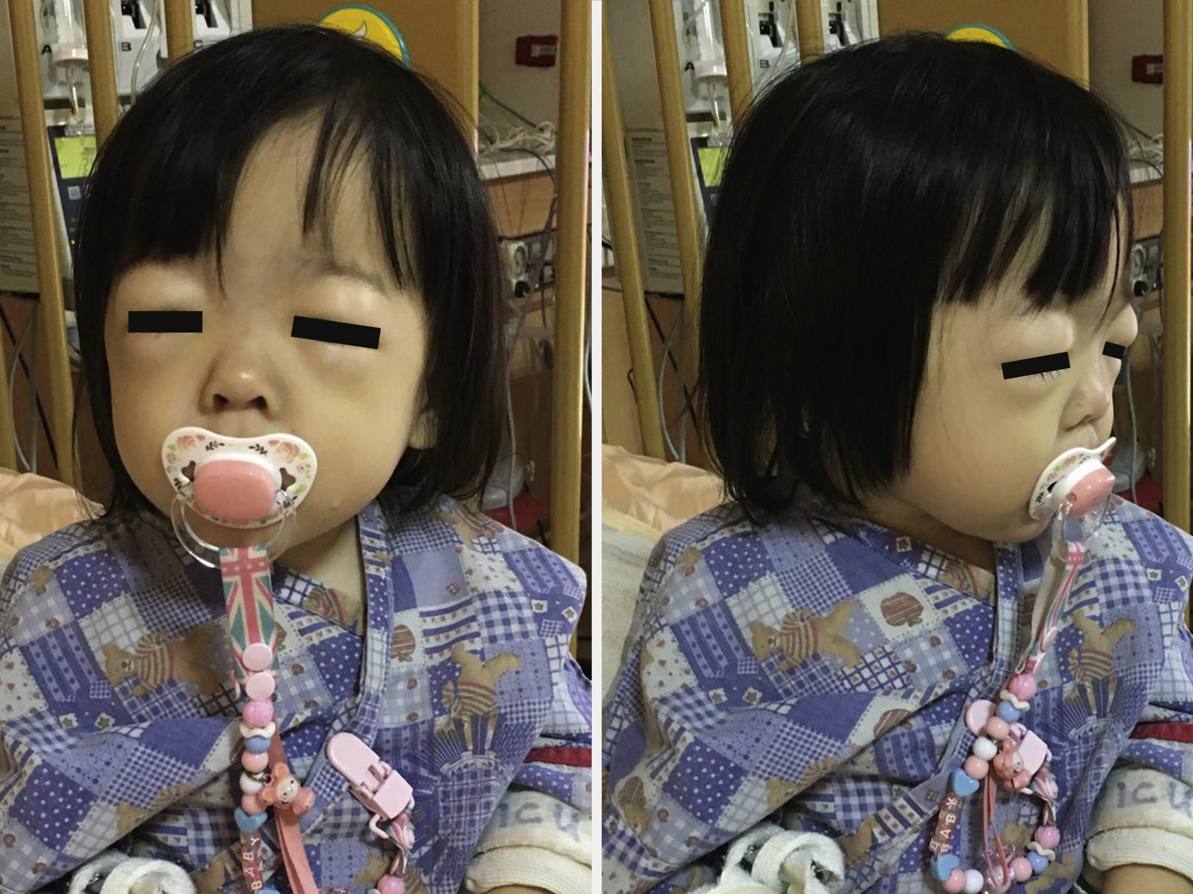
Puffy eyes

Slide 52
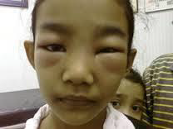
Puffy eyes

Slide 53
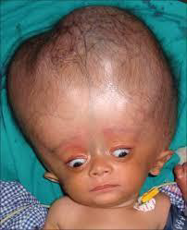
Hydrocephlus:
*Increased head circumferanc
*Separation of sutures
*Tense large anterior fontanel
*Persistent posterior fontanel
*Widely opened fontanels
*Scalp veins may be dilated
*Sun set eye apperance

Slide 54
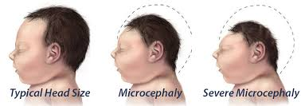
Microcephaly:
*Decrease craniofacial dispropotion.
*May closed sutures ((Craniocynstosis
*May appear signs of increased intracranial tension in craniocynstosis.)

Slide 55
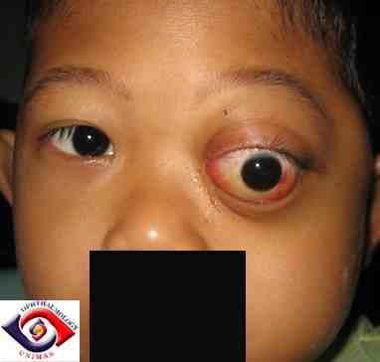
Proptosis:

Slide 56
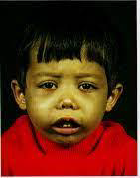
Thalassemic facies:
*Frontal and parietal bossing
*Prominent maxilla
*Exposure of upper central incisors and apparently depressed nasal bridge.
*pallor, jaundice, hemosiderosis combined to give greenish brown skin.

Slide 57
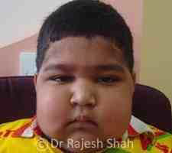
Cushinoid facies:

Slide 58
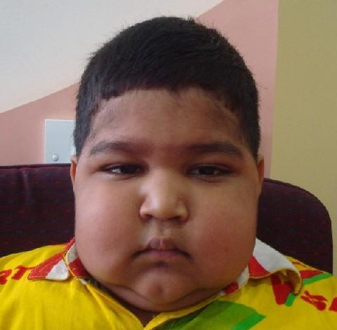
Cushinoid face:
Causes:
*cushing syndrome
*iatrogenic corticosteroid

Slide 59
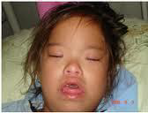
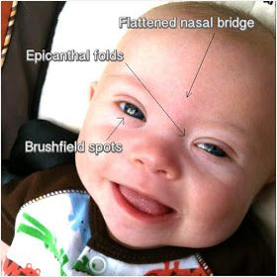
Down facies (mongolian facies)
*Upward and outward slanting of eye.
*Medial epicanthic folds.
*Depressed nasal bridge.
*Small mouth cavity with protruded tongue.
*Low set ears.
*Short neck.

Slide 60
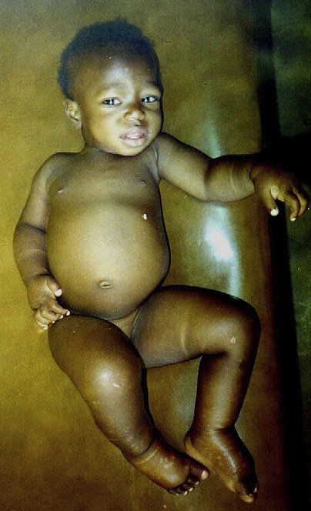
Kwashirkor:
*Apathy
*doll face
*Edema
*Brittle thinning hair with Flag sign
*Carcky paint dermatosis

Slide 61
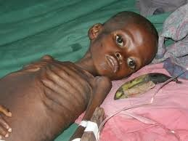
Marasmus:
Loss of subcutanous fat, muscle from
abdomen , trunk, limbs , face (senile facie)

Slide 62
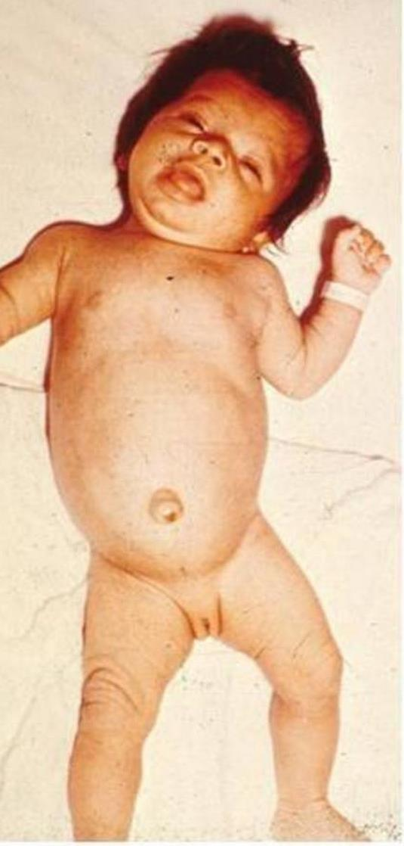
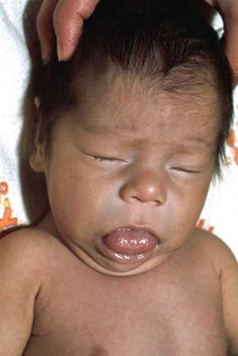
Cretinism (congenital hypothyrodisim)
*Coarse brittle hair , hair line reach far down on forehead
*eyes appear faraway with narrow palpebral fissure.
*depressed nasal bridge.
*open mouth with large protruded tongue
*thick , short neck

Slide 63
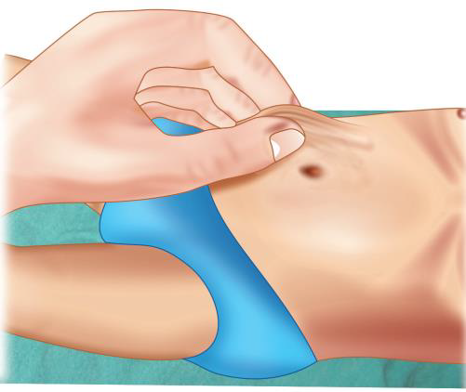
Method of skin turgor examination:

Slide 64
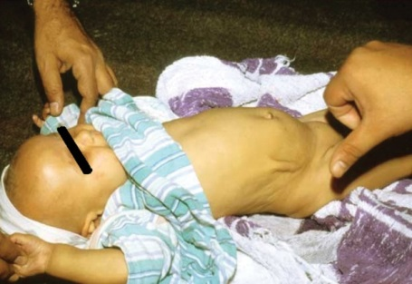
Delayed skin turgor in dehydration:

Slide 65
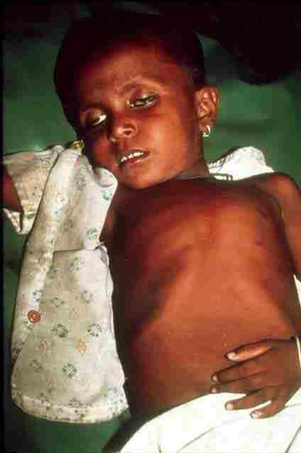
Dehydrated with sunken eyes:

Slide 66

Signs of dehydration

Slide 67

Oral monaliasis:

Slide 68

Follicular tonsilitis:

Slide 69
Neck examination:
Abnormal position
Thyroid gland
Carotid pulse
Lymph nodes enlargement
JVP : congested or not, pulsating or not

Slide 70


Slide 71
:Lymph nodes
*If abnormal is size or texture record location, consistency, tenderness, size in centimeters.
:*Significant lymph node enlargement
more than 1,5 CM in inguinal region
more than 1 CM in axillary
more than 2 CM ant. Cervical
more than .5 CM in supraclavicular and epitrochlear
*Tender if inflammation (acute)
*not tender if malignant
*Matted : TB
*Fixed: malignancy
*Generalized : TB , leukemia and lymphoma.
*firm or hard : malignancy.
*Regional : infection
*Generalized : more than 2 groups in systemic disease

Slide 72


Slide 73
Groups of lymph nodes:
•inguinal
•axillary
•epi trochlear
•cervical LNs: circular or vertical.
circular : submental ,submandibular , preauricular, postauricular , occipital.
Vertical:
ant.cervical , post cervical , supraclavicular lymph nodes .
note : Lt supraclavicular LNs (virchows LNs) …are mirror for the intraabdominal problems
Rt supraclavicular LNs: in intrathoracic problems

Slide 74
Upper limbs examination:
Capillary refill
Nails: splinter he (in infective endocarditis),
Spooning
Pallor: in anemia
Clubbing: pale or cyanotic
-pale: infective endocarditis
-cyanotic: congenital cyanotic heartdisease,
Grades of clubbing:
1st: oblitrated angel
2nd: parrot peak
3rd: drumstick
4th: hypertrophic osteoarthropathy
Short fingers( brachydactly), any deformities or swelling, Thumb anomaly
Semian crease, curved little finger( clinodactyly).. ( down $)
Osler nodules, Janeway spots ( infective endocarditis)
Broadening of distal ends of radius & ulna (rickets)
Skin rash

Slide 75
Peripheral perfusion:
cold cyanotic in poor peripheral perfusion
capillary refill test :
normal: 1 to 2 seconds.
Prolonged if more than 2 sec.
Palpation of the radial pulse:
That felt over the distal part of radial artery at the wrist
Brachial pulse:
that which is felt over the brachial artery at the inner aspect of the elbow

Slide 76


Slide 77


Slide 78

Normal fingers:

Slide 79


Slide 80

Window test :

Slide 81

:Parrot peak appearance

Slide 82

Drum stick clubbing:

Slide 83

Hypertrophic osteodystrophy:

Slide 84

splinter hemorrhage

Slide 85
Lower limbs :
, clubbing, sandal gap in down, Marfan sign in rickets, lower limb odema, skin rash, bow knee or knock knee ,
Palpation of the dorsalis pedis and post.tibial artery
Dorsalis pedis:
Just lateral to extensor tendon of the big
toe.
post. Tibial artery:
Behind medial malleolus.

Slide 86

Pitting edema in foot:

Slide 87

Lower limb edema

Slide 88


Slide 89
Steps of the skill
Items to be fulfilled
Patients’ greeting
Introduce yourself to the patient
Take the permission and explain to him or her what you are going to do
Make sure there is a good light, and that the room is warm
Proper position of the patient according to each item
Proper exposure of the patient according to each item
Maintain confidentiality and respect to the patient
Items to be used in general examination
General appearance of the patient Alert or not-Well or comfortable or not, Average or under or over body built) )Nutritional status Dehydrated or not)) Hydration status
Vital signs Heart rate -Blood pressure -Respiratory rate- Temperature
Anthropometric measures Weight Length or height Head circumference

Slide 90
Head examination Complexion (pallor-jaundice-cyanosis) Shape –Facies ( down, thalassemic , doll , senile , cretinism) Congenital anomalies
Neck examination Abnormal position (stiff-retracted-tilted) Lymph nodes- Thyroid-Jugular venous pressure
Upper limb examination Capillary refill - Clubbing - Joints swellings Hand deformities (polydactyl-Brachydactyly-simian crease-Broadening of lower ends of radius and ulna)
Lower limb examination Joints swellings -Clubbing-Edema Deformities (Rachitic bow legs- Marfan sign)
Lymph node examination Cervical-epi trochlear-Axillary-Inguinal
At the end cover the exposed areas and thank him or her for cooperation

